Slide 1
Big Data

Slide 2
Information Storage
Data
Data is a collection of raw facts from which conclusions might be drawn.
Examples include
Handwritten letters, a printed book, a family photograph, a bank’s ledgers, and an airline ticket are all examples that contain data.

Slide 3
Information Storage
Digital data
Before the advent of computers, the methods adopted for data creation and sharing were limited.
Today, the same data can be converted into more convenient forms, such as an e-mail message, an e-book, a digital image, or a digital movie. This data can be generated using a computer and stored as strings of binary numbers (0s and 1s).
Data in this form is called digital data and is accessible by the user only after a computer processes it.

Slide 4
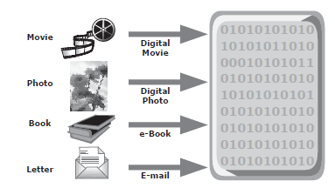
Digital data

Slide 5
Big data
'Big Data' is also a data but with a huge size.
Big data refers to extremely large and complex datasets that cannot be processed or analyzed using traditional data processing methods and tools.
The term "big data" refers to not only the size of the dataset but also the Volume, velocity, and varietyof the data.

Slide 6
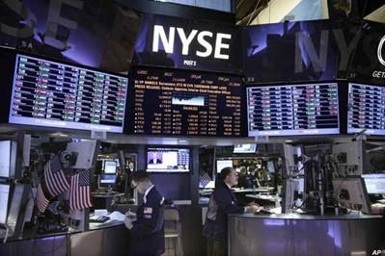
Examples Of 'Big Data'
The New York Stock Exchange generates about one terabyte of new trade data per day.

Slide 7

Social Media Impact
Statistic shows that 500+terabytes of new data gets ingested into the databases of social media site Facebook, every day.
This data is mainly generated in terms of photo and video uploads, message exchanges, putting comments etc.

Slide 8

Single Jet engine can generate 10+terabytes of data in 30 minutes of a flight time. With many thousand flights per day, generation of data reaches up to many Petabytes.

Slide 9
Categories Of 'Big Data'
Big data could be found in three forms:
Structured
Unstructured
Semi-structured

Slide 10
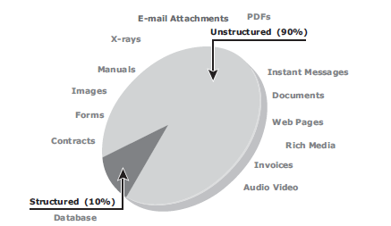

Slide 11
Structured
Any data that can be stored, accessed and processed in the form of fixed format is termed as a 'structured' data.
Employee_ID | Employee_Name | Gender | Department | Salary_In_lacs
2365 | Rajesh Kulkarni | Male | Finance | 650000
3398 | Pratibha Joshi | Female | Admin | 650000
7465 | Shushil Roy | Male | Admin | 500000
7500 | Shubhojit Das | Male | Finance | 500000
7699 | Priya Sane | Female | Finance | 550000

Slide 12
Unstructured
Any data with unknown form or the structure is classified as unstructured data.
In addition to the size being huge, un-structured data poses multiple challenges in terms of its processing for deriving value out of it.
Typical example of unstructured data is, a heterogeneous data source containing a combination of simple text files, images, videos etc.
Now a day organizations have wealth of data available with them but unfortunately they don't know how to derive value out of it since this data is in its raw form or unstructured format.

Slide 13
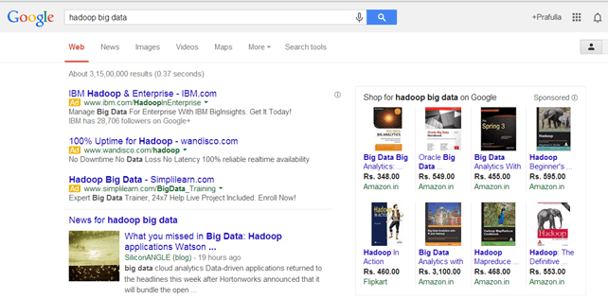
Examples Of Un-structured Data
Output returned by 'Google Search‘

Slide 14
Semi-structured
Semi-structured data can contain both the forms of data.
We can see semi-structured data as a structured in form but it is actually not defined with e.g. a table definition in relational DBMS.
Semi-structured data is information that doesn’t reside in a relational database but that does have some organizational properties that make it easier to analyze.
Example of semi-structured data is a data represented in XML file.
XML files are widely used for a variety of purposes, such as configuration files for software applications, data exchange between systems, and web services. They provide a standard and flexible format for storing and exchanging data that can be easily processed and manipulated by software applications.

Slide 15
Need for Big Data
Nowadays data come in different forms.
Many of the analytical solutions were not possible in the past due to the cost of implementation and lack of professionals.
With this, we are capable of performing complex algorithms on machine data within a time interval.
These have many real-time use cases such as fraud-detection, targeting audience on a global platform, web advertising, etc.

Slide 16
Characteristics of Big Data
The three main characteristics of big data are often referred to as the "3Vs":
Volume: Big data is characterized by large volumes of data that are often measured in terabytes, petabytes, or even exabytes.
Velocity: Big data is often generated and processed in real-time or near-real-time, which means that the data is constantly flowing and needs to be processed quickly.
Variety: Big data is often unstructured or semi-structured, which means that it comes in many different forms, including text, images, video, audio, and social media data.

Slide 17
Benefits of Big Data Processing
Traffic Control
Manufacturing
Telecom
Trading Analytics
Search Quality
Business intelligence and analytics
Fraud detection and prevention
Recommendation engines
Sentiment analysis and social media monitoring
Predictive maintenance in manufacturing
Personalized healthcare and medicine

Slide 18
Big data ecosystem
The big data ecosystem consists of the following:
1. Devices that collect data from multiple locations and also generate new data about this data (metadata).
2. Data collectors who gather data from devices and users.
3. Data aggregators that compile the collected data to extract meaningful information.
4. Data users and buyers who benefit from the information collected and aggregated by others in the data value chain.

Slide 19
NoSQL
NoSQL is an approach to database design that can accomodate a wide variety of data models, including key-value, document, columnar and graph formats.
NoSQL, which stand for "not only SQL," is an alternative to traditional relational databases in which data is placed in tables and data schema is carefully designed before the database is built.
NoSQL databases are especially useful for working with large sets of distributed data.

Slide 20
Major issues of Relational Databases
Relational databases were designed for tabular data, with a consistent structure and a fixed schema. They work best for problems that are well defined at the outset. But not good to manage unstructued data.
A Large Number of JOINs
When you utilize queries that join many different tables, there’s an explosion of complexity and computing resource consumption. This results in a corresponding increase in query response times.
Frequent Schema Changes
Slow-Running Queries (Despite Extensive Tuning)

Slide 21
Why NoSQL
Document Oriented Storage: Data is stored in the form of JSON style documents.
Replication and high availability
Fast in-place updates

Slide 22
Characterisics of NoSQL
It’s more than rows in tables—NoSQL systems store and retrieve data from many formats: key-value stores, graph databases, column-family (Bigtable) stores, document stores, and even rows in tables.
It’s free of joins—NoSQL systems allow you to extract your data using simple interfaces without joins.
It’s schema-free—NoSQL systems allow you to drag-and-drop your data into a folder and then query it without creating an entity-relational model.
It works on many processors—NoSQL systems allow you to store your database on multiple processors and maintain high-speed performance.
It uses shared-nothing commodity computers—Most (but not all) NoSQL systems leverage low-cost commodity processors that have separate RAM and disk.
It supports linear scalability—When you add more processors, you get a consistent increase in performance.

Slide 23
Data Models of NoSQL/NoSQL databases
Key-value datamodel/ Key-value stores
Document data model/ Document database
Column Family data model/ Column-family stores
Graph data model/ Graph databases

Slide 24
NoSQL databases are often used in large-scale web applications and other systems that require high scalability and performance.
They are also popular in big data and real-time analytics applications where data is constantly changing and needs to be processed quickly.

Slide 25
Thank You

